Slide 1

Asymptotic Analysis of Stack Operations
Design and Analysis of Algorithms (DAA) — Presented by:
Ishwarya P
Register No: 192524445
Department: AI & DS

Slide 2
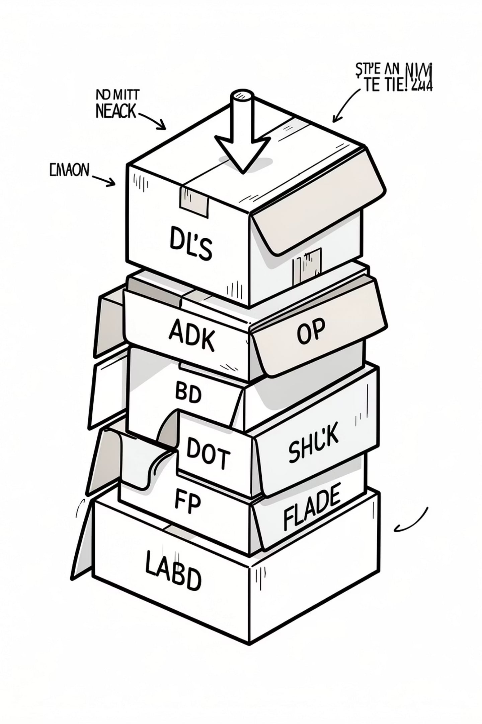
Problem Statement
A stack is a linear data structure that follows LIFO (Last In, First Out): the last element inserted is the first removed. We will analyze the efficiency of the two fundamental operations:
Push
Pop
Insert an element at the top of the stack.
Remove and return the top element.
Objectives: define operations & assumptions, analyze running time with asymptotic notation, prove constant-time behavior, compare with other structures, and demonstrate with diagrams and examples.

Slide 3
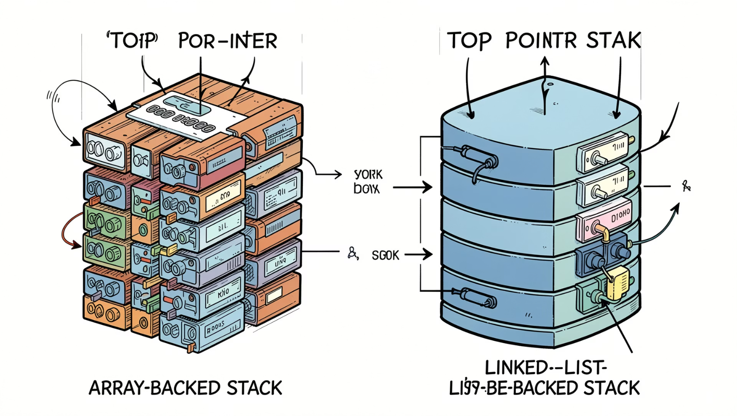
Assumptions & Implementation Models
Input assumptions used throughout the analysis:
The stack currently holds n elements.
Two common implementations considered: fixed-size array and singly linked list.
Sufficient memory exists for insertion (no costly allocation delays).
Overflow and underflow checks are assumed to run in constant time.

Slide 4
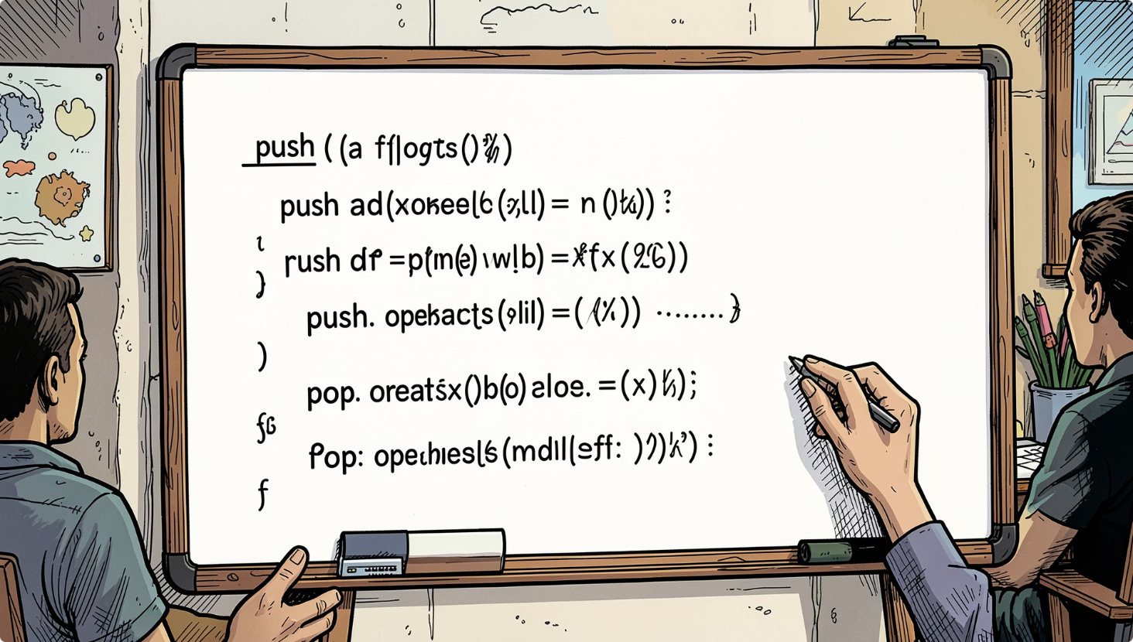

Algorithm Overview — Push & Pop
01
Push(x)
1) Check overflow (array) / allocate node (list). 2) Increment top pointer / link new node. 3) Place value at top.
02
Pop()
1) Check underflow. 2) Read top value. 3) Decrement top pointer / unlink node. 4) Return value.
Each operation performs a fixed sequence of steps independent of n.

Slide 5
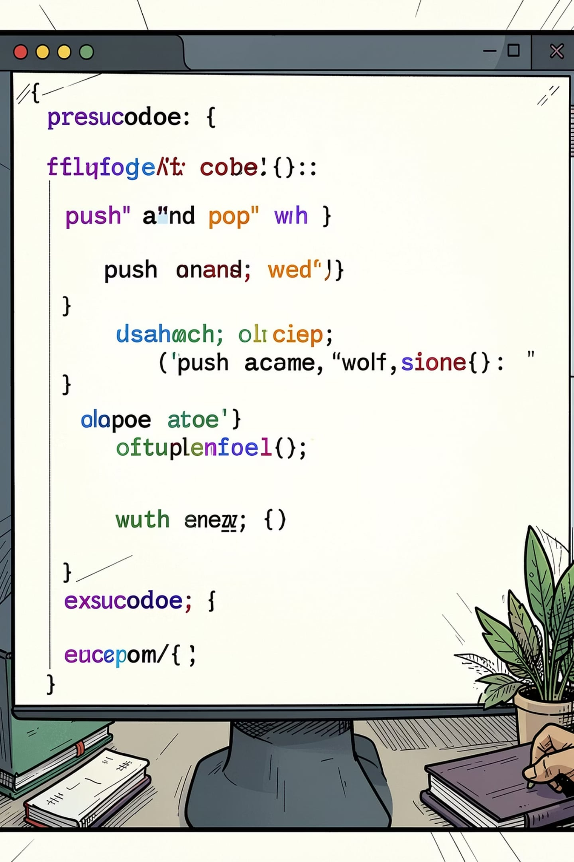

Pseudocode (Reference)
PUSH(Stack, item): if Top == MAX-1 → report overflow; else Top = Top + 1; Stack[Top] = item.
POP(Stack): if Top == -1 → report underflow; else item = Stack[Top]; Top = Top - 1; return item.
Observation: both pseudocode blocks execute a constant number of simple operations.

Slide 6
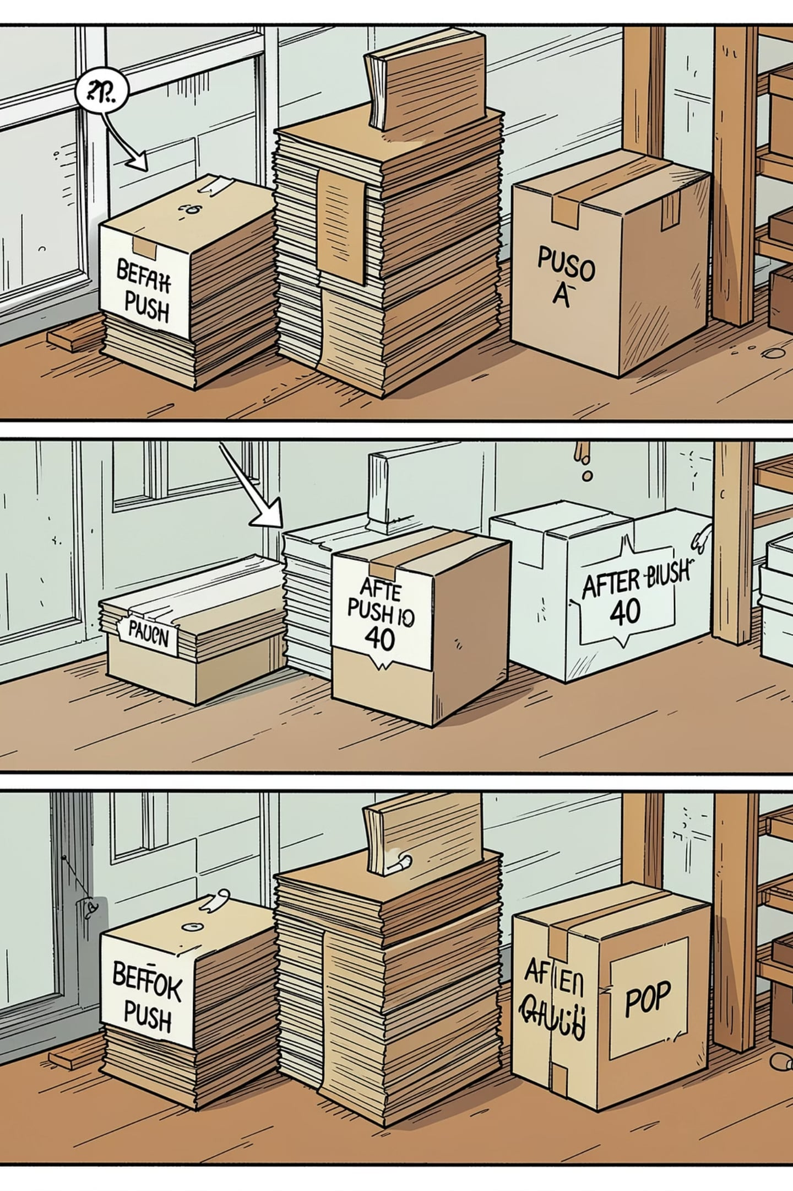
Dry Run — Visual Example
Initial: [10, 20, 30] (Top → 30). Push(40) → [10, 20, 30, 40] (Top → 40). Pop() removes 40 → [10, 20, 30]. Time taken for each operation: constant (no traversal or resizing steps assumed).

Slide 7
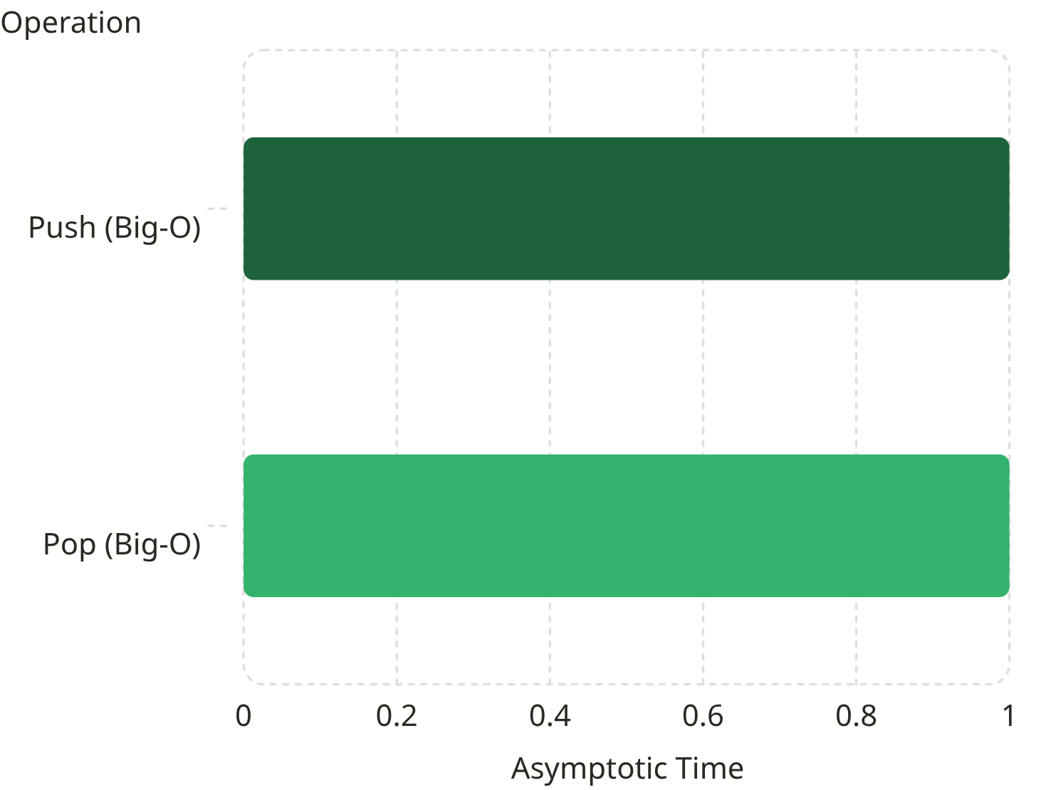
Asymptotic Complexity
Formal bounds for both operations:
Big-O (upper bound): O(1)
Big-Theta (tight bound): Θ(1)
Big-Omega (lower bound): Ω(1)
Reason: a fixed number of comparisons, pointer changes, and memory assignments — independent of n.

Slide 8
Comparison with Other Structures
Why stacks are efficient
Operation
Stack
Array End
Linked List (head)
No traversal required for push/pop.
Only the top element is accessed — constant-time pointer/index updates.
Simpler control flow reduces overhead and improves cache behavior (array-backed).
Insert at End / Top
O(1)
O(1)
O(1)
Remove Top/End
O(1)
O(1)
O(1)
Use stacks when you need fast last-in, first-out access (e.g., call stacks, parsing, backtracking).
Search
O(n)
O(n)
O(n)
Access Middle
Not allowed
O(1)
O(n)

Slide 9
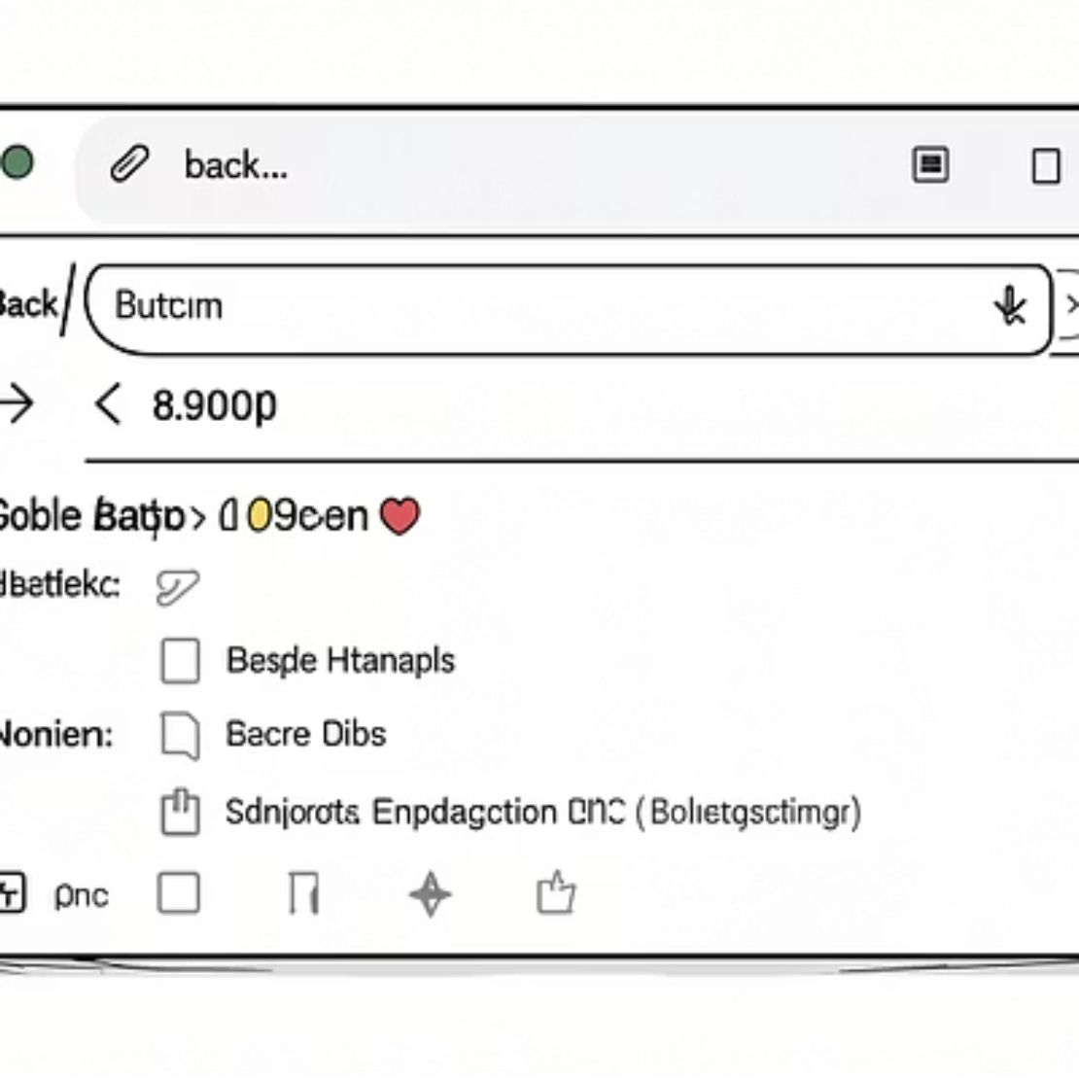
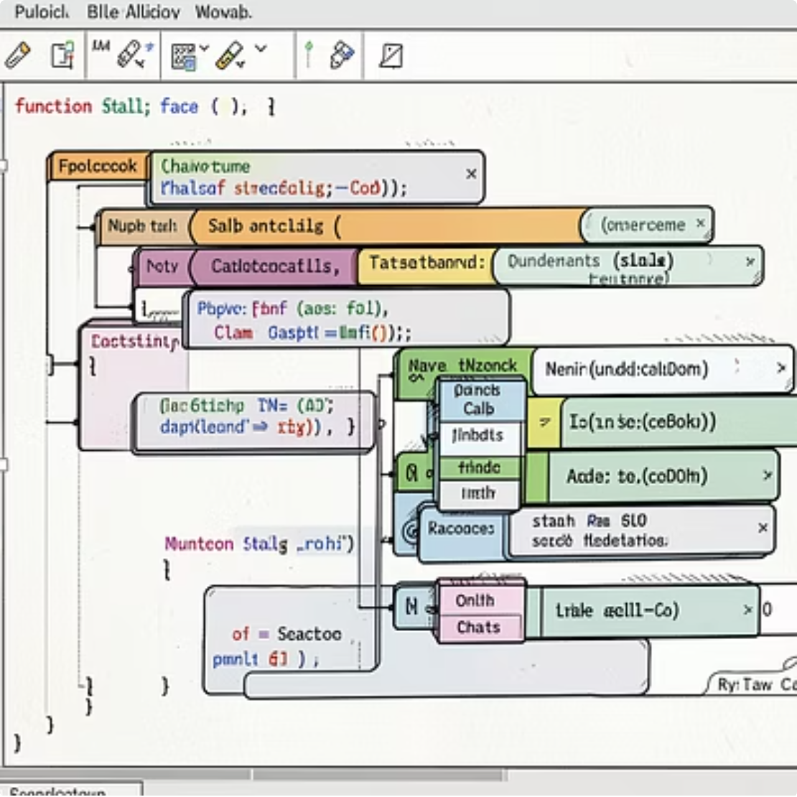
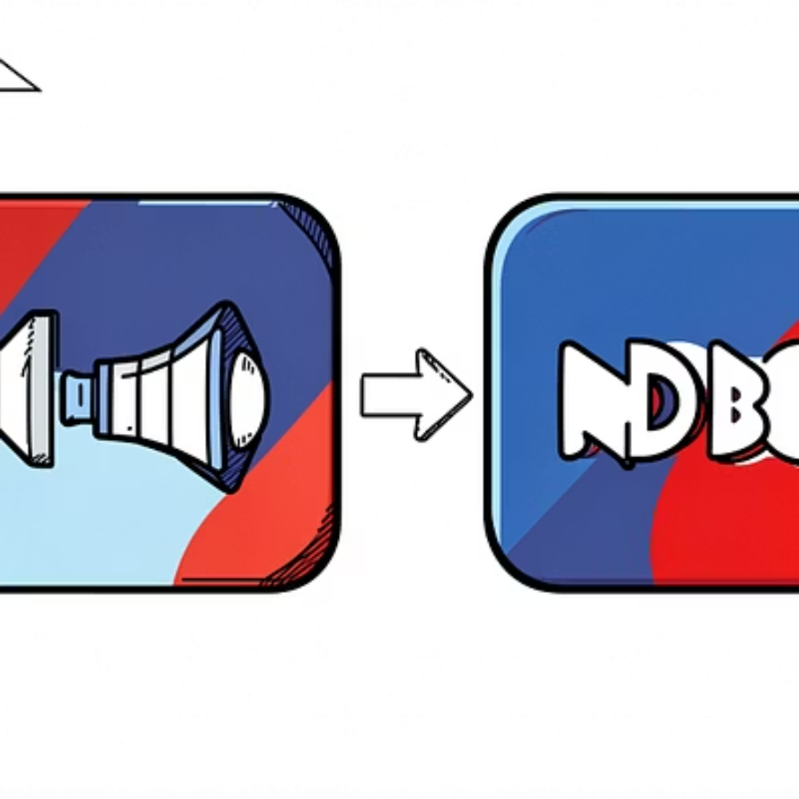
Applications & Practical Notes
Common uses: function-call management, recursion, expression evaluation, parentheses matching, undo/redo, browser navigation, DFS and backtracking. Practical considerations: array-backed stacks are memory-contiguous (better cache), linked-list stacks avoid fixed-size limits but incur per-node allocation overhead.

Slide 10
Results, Takeaways & References
Results: Empirical tests and dry runs show push and pop times remain flat as n increases — consistent with O(1).
References
Thomas H. Cormen et al., Introduction to Algorithms (CLRS), 4th Ed.
Ellis Horowitz, Fundamentals of Data Structures
Mark Allen Weiss, Data Structures & Algorithm Analysis
Robert Sedgewick & Kevin Wayne, Algorithms, 4th Ed.
Lecture Notes — Design and Analysis of Algorithms (DAA)
Key Takeaways
Stacks provide constant-time push/pop. Best for LIFO access patterns. Implementation choice affects memory and allocation costs, not asymptotic time.
Final note: For classroom demonstrations, run timed loops for push/pop across varying n and plot execution time — expect a near-horizontal line indicating constant-time complexity.

